Slide 1
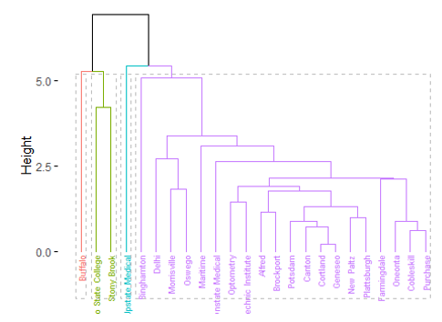
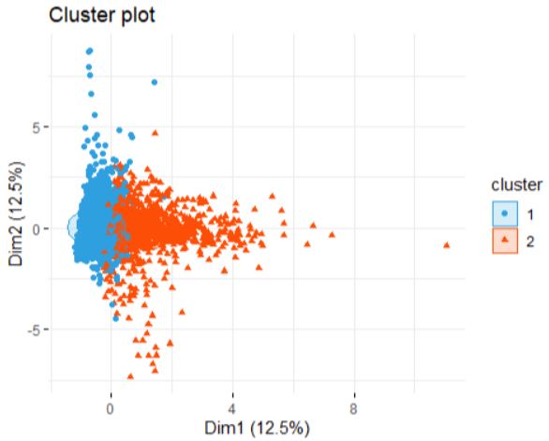




Clustering Analysis of College Crime Data and E-commerce Customer Data
A Comparative Study of Partitioning and Hierarchical Clustering Methods
Team Members
Bhawik
Alice
Hassan
Abrar

Slide 2
INTRODUCTION
Objective: To explore clustering tendencies in two distinct datasets, validate clusters, and compare the results using different clustering methods in order to extract meaningful patterns relevant to safety and customer behavior.
Hierarchical Clustering
Partitioning Clustering
To analyze crime statistics across different universities and colleges in New York and uncover patterns or groupings using hierarchical clustering.
Used for the e-commerce customer data to segment the customer base into distinct groups based on purchasing patterns using methods like K-Means and PAM (Partitioning Around Medoids).
Research Significance: The study will demonstrate how specialized clustering techniques can yield actionable insights that inform decision-making in campus security and marketing strategies in e-commerce.

Slide 3
DATASET FOR Hierarchical Clustering
DATA COLLECTION
1
№ | Feature | Description
1 | Campus | Specific campus of the university or college.
2 | Student Enrollment | Number of students enrolled at the campus.
3 | Violent Crime | Total instances of violent crimes reported.
4 | Murder and Nonnegligent Manslaughter | Instances of murder or nonnegligent manslaughter reported.
5 | Rape | Number of rapes reported.
6 | Robbery | Number of robberies reported.
7 | Aggravated Assault | Number of aggravated assaults reported.
8 | Property Crime | Total property crimes reported.
9 | Burglary | Number of burglaries reported.
10 | Larceny-Theft | Number of larceny-theft incidents reported.
11 | Motor Vehicle Theft | Number of motor vehicle thefts reported.
12 | Arson | Number of arson cases reported.
Name : New York Offenses Known to Law Enforcement by University and College, 2019
Data Source : FBI Uniform Crime Reporting (UCR) Program (https://shorturl.at/unSho)
Representing crime statistics for different campuses
25 RECORDS
Providing various aspects of reported crimes
12 FEATURES

Slide 4
IMPACTFUL APPLICATIONS
01
03
Campus Safety Assessment Enables informed decision-making for students and strategic planning for administrators to enhance safety.
Insightful Trend Analysis Monitors changes in crime patterns and explores demographic and environmental correlations.
02
04
Guiding Policy Initiatives Aids in developing precise crime prevention strategies and efficient use of enforcement resources.
Transparency and Engagement Increases accountability through data transparency and encourages community dialogue on safety measures.

Slide 5
DATA PREPROCESSING
Student enrollment figures of campus Nanoscale Science and Engineering were not available, so we drop this row.
Missing Values
Exploratory Data Analysis
We found out few outliers for each variable, but this is because certain campuses have higher crime rates than others, so it is important to retain these for further analysis.
Outlier Detection
Histogram Summary
Valuable insights clearly illustrating that most colleges have low crime rates with skewed distributions towards fewer incidents
Student Enrollment: Distribution is right-skewed with most colleges having low enrollments.
Violent Crimes: Generally low across colleges with notable decreases in higher incident rates.
Property Crimes: Mostly low but with slightly more frequent incidents of larceny-theft compared to other crimes.

Slide 6
DATA PREPROCESSING
Correlation Analysis
Highlights significant relationships between campus size and crime rates, as well as strong interconnections among various types of crimes.
Exploratory Data Analysis
01 | Student Enrolment Correlations:
 | Violent Crime: Strong correlation (0.7426) indicates higher incidents in larger schools. Property Crime: Very strong correlation (0.7952) aligns with increased rates in bigger institutions. Larceny-Theft: Significant correlation (0.7900) prevalent in larger schools.
02 | Crime Type Interrelations:
 | Violent vs. Property Crimes: High correlation (0.8491) suggesting parallel trends. Aggravated Assault: Strongly correlated with both violent (0.8251) and property crimes (0.8581). Larceny-Theft: High correlation with property crimes (0.9978) indicates it's a major component.

Slide 7
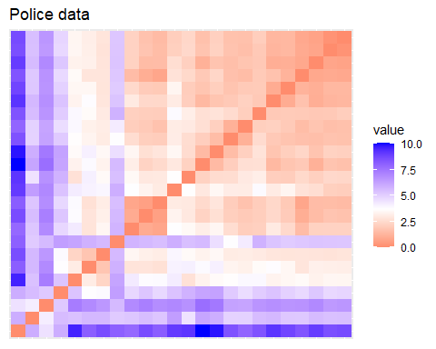
ASSESSING CLUSTERING TENDENCY
Why It's Important?
Assessing clustering tendency is crucial to determine if the data naturally groups into clusters, which validates the applicability of clustering algorithms. Without this step, applying clustering methods could yield misleading or non-informative results.
Crime Data
0.8817
Hopkins statistic
Clear Blocks
VAT Heat Map
Indicates meaningful clusters
Darker colors along the diagonal, indicating the presence of clusters

Slide 8
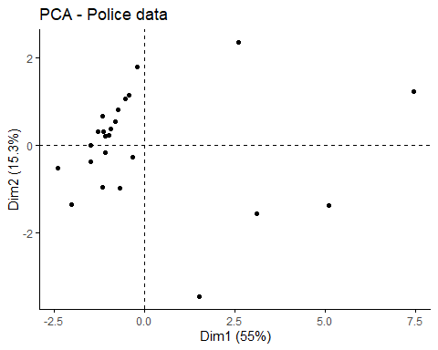
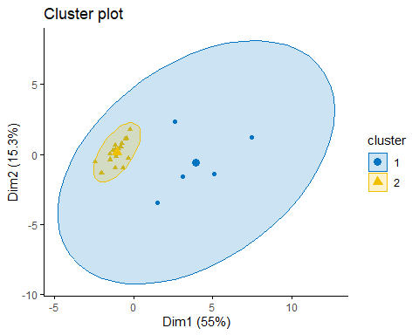
VISUAL INSPECTION OF DATA CLUSTERS
Principal Components: The first principal component (Dim1) explains 55% of the variance in the data, while the second principal component (Dim2) explains 15.3% of the variance. Together, these two components capture 70.3% of the total variance.
Data Distribution: The plot shows a cluster of data points around the origin, indicating that most schools have similar characteristics regarding the variables studied. A few data points are outliers, suggesting that some schools have unique characteristics or higher incidences of certain variables compared to the rest.

Slide 9
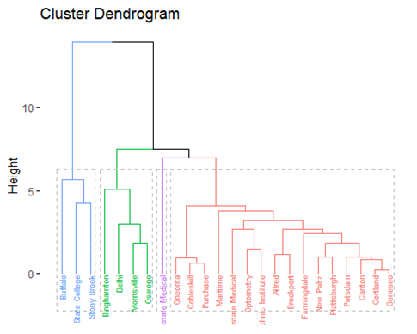
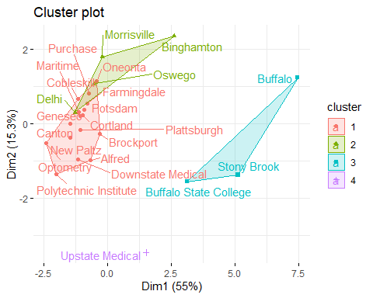
HIERARCHICAL CLUSTERING
1. Ward.D2 Linkage
Ward's method minimizes the sum of squared differences within all clusters. It is particularly useful for identifying compact, spherical clusters.

Slide 10
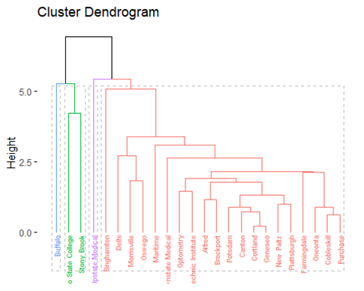
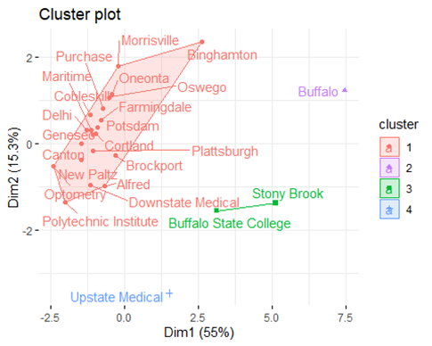
HIERARCHICAL CLUSTERING
2. Average Linkage
Average linkage takes the average distance between all pairs of points in any two clusters. It is suitable for creating clusters that vary in size.

Slide 11
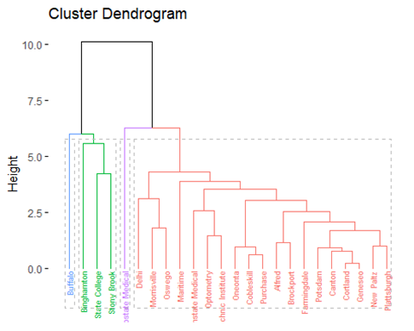
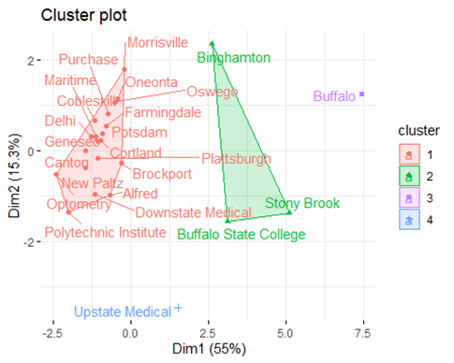
HIERARCHICAL CLUSTERING
3. Complete Linkage
This method forms clusters by considering the maximum distance between pairs of points from different clusters. It tends to produce more homogeneous and tightly bound clusters, which are suitable for data where outliers are not prevalent

Slide 12
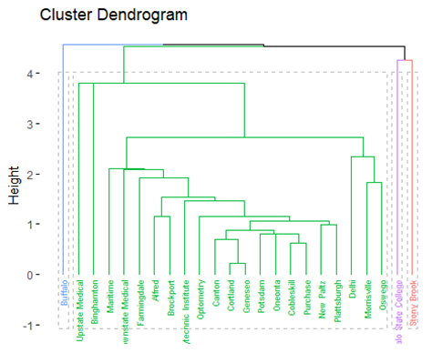
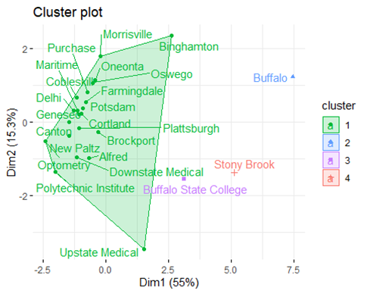
HIERARCHICAL CLUSTERING
4. Single Linkage
This method forms clusters by considering the maximum distance between pairs of points from different clusters. It tends to produce more homogeneous and tightly bound clusters, which are suitable for data where outliers are not prevalent

Slide 13
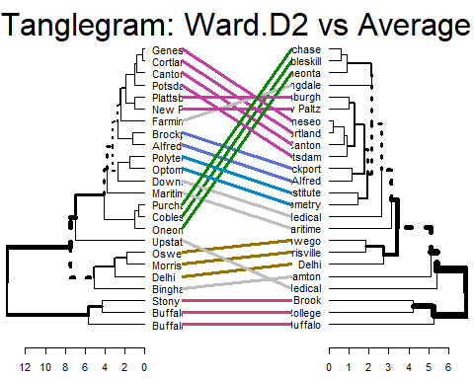
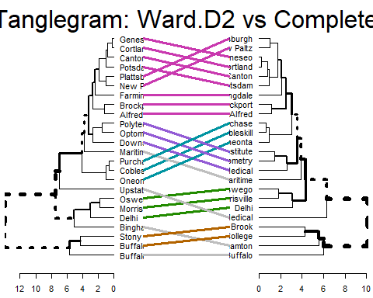
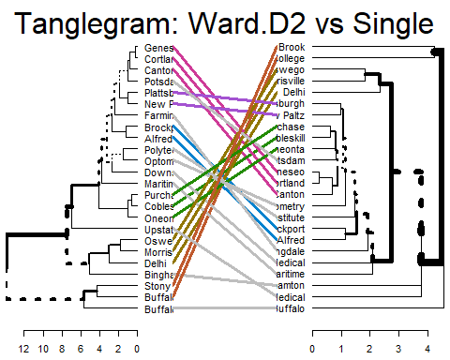
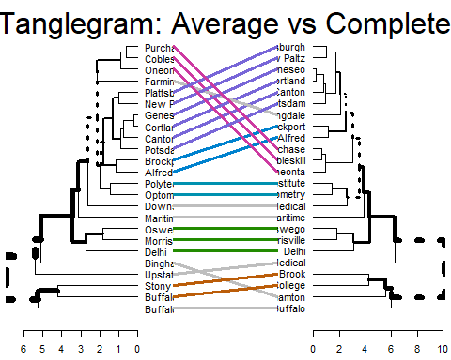
COMPARATIVE ANALYSIS OF DENDROGRAMS
Purpose: To evaluate how different methods—Ward.D2, Average, Complete, and Single—reveal varied structures within the same dataset.
Entanglement Analysis
Ward.D2 vs Average: Low entanglement (0.22) suggests somewhat similar clustering structures.
Ward.D2 vs Complete: Very low entanglement (0.08) indicates very similar clustering structures, suggesting compatibility in clustering approach.
Ward.D2 vs Single: High entanglement (0.64) indicates significant differences in clustering patterns.
Average vs Complete: Low entanglement (0.14) suggests similar structures.
Average vs Single and Complete vs Single: Moderate entanglement (0.50 and 0.52, respectively) shows noticeable differences but not as distinct as with Ward.D2.
Conclusion: Ward.D2 and Complete methods produce the most similar structures, while Single method often diverges significantly from others.

Slide 14
COMPARATIVE ANALYSIS OF DENDROGRAMS
Purpose: To evaluate how different methods—Ward.D2, Average, Complete, and Single—reveal varied structures within the same dataset.
Correlation Metrics
Cophenetic Correlations
Highest between Average and Single (0.974), suggesting very similar clustering outputs.
Lowest between Ward.D2 and Complete (0.878), indicating some differences in clustering approaches.
Baker Correlations
Consistently high correlations, with the highest between Average and Single (0.965).
Supports the cophenetic findings, indicating similar clustering trends between methods with minor variations.
Conclusion: Both cophenetic and Baker correlations reinforce the findings from entanglement analysis, showing that while there are some differences, many methods share underlying similarities in clustering outputs.

Slide 15
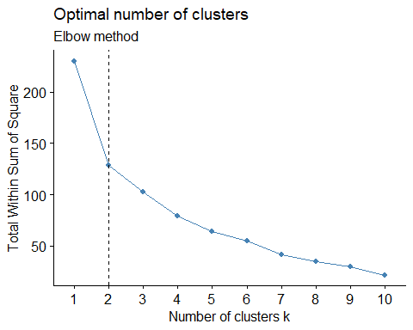
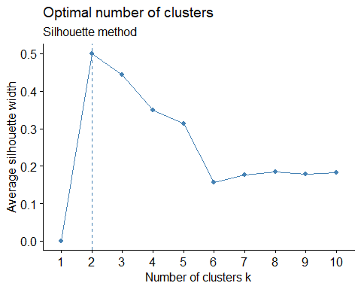
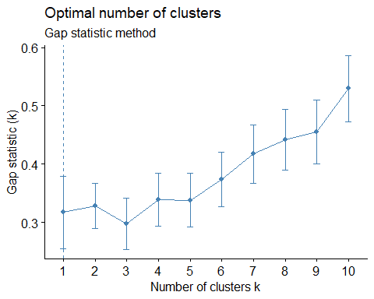
CHOOSING THE OPTIMAL NUMBER OF CLUSTERS
Elbow
Method
2 Clusters
Silhouette
Method
2 Clusters
Gap Statistic
Method
1 Cluster

Slide 16
CLUSTER VALIDATION STATISTICS
01
02
INTERNAL VALIDATION MEASURES
EXTERNAL VALIDATION MEASURES
Silhouette Score
Dunn Index
Connectivity
Rand Index
Adjusted Rand Index
Meila’s VI

Slide 17
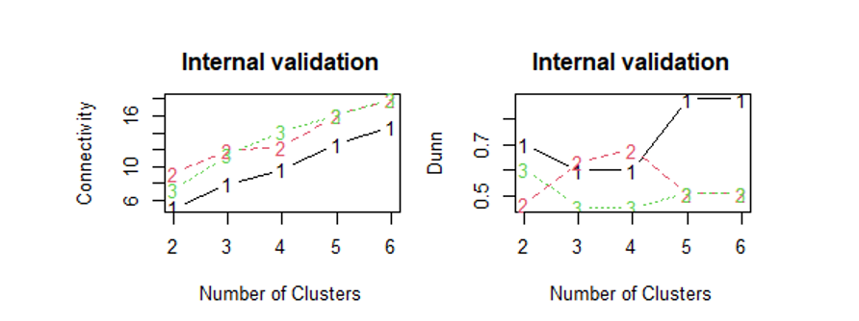
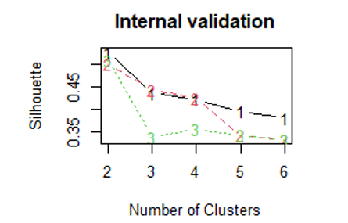
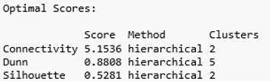
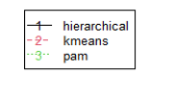
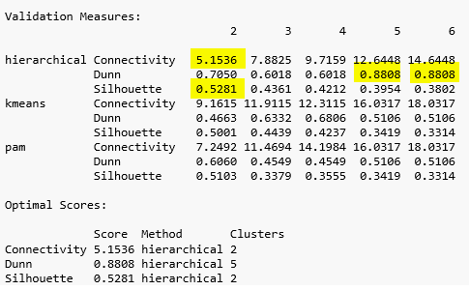
INTERNAL VALIDATION MEASURES
Connectivity: Measures how well the clusters are linked, lower values are better.
Dunn Index: Evaluates intra-cluster compactness and inter-cluster separation; higher values indicate better clustering.
Silhouette Score: Assesses how similar an object is to its own cluster compared to other clusters; values closer to 1 suggest well-defined clusters.
Conclusion
Hierarchical Clustering Recommended: Based on internal validation metrics, hierarchical clustering with two clusters is most effective, achieving the lowest connectivity and highest silhouette score.
Considerations: Dunn index highlights potential for five clusters, suggesting a need to balance cluster compactness against separation depending on specific analytical goals.

Slide 18
EXTERNAL VALIDATION MEASURES
These measures compare the clustering results to an external standard or ground truth, often in the form of pre-labeled data.
External validation measures were not utilized in this analysis
Reason for Exclusion
Lack of Ground Truth: Our dataset does not include any external labels or pre-defined cluster assignments that could be used as a benchmark for external validation.
Focus on Data-Driven Insights: The aim was to discover natural groupings and patterns within the data itself rather than validating against pre-set categories.

Slide 19
STABILITY MEASURES IN CLUSTER VALIDATION
Importance
Ensuring stability in clustering is crucial for confirming that the identified clusters are reliable and not artifacts of specific data peculiarities or the clustering process.
FOUR TYPES
Average Proportion of Non-overlap (APN) | Measures the average dissimilarity between clusters obtained from the dataset and those from subsamples.
Average Distance (AD) | Calculates the average distance between elements in the same cluster across different clustering solutions.
Figure of Merit (FOM)ween Means (ADM) | Evaluates the stability of cluster centroids by measuring the distance between centroids in different subsamples.
Regression analysis | Focuses on the within-cluster dispersion and its variation across different subsamples.

Slide 20
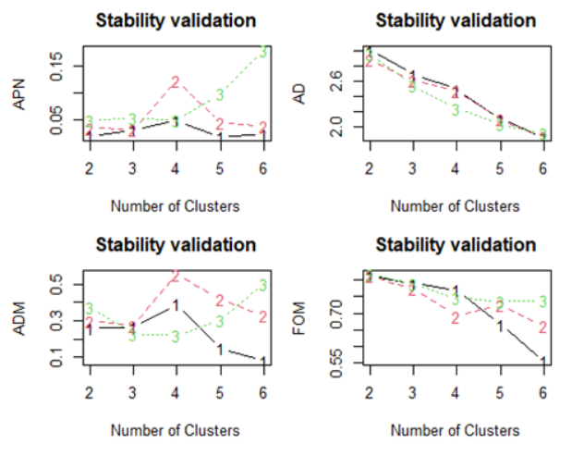
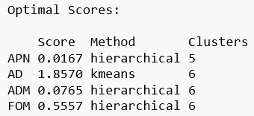
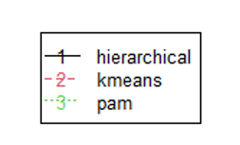
STABILITY MEASURES IN CLUSTER VALIDATION
Hierarchical clustering achieves optimal stability for APN, ADM, and FOM with 6 clusters.
K-means clustering achieves the best AD score with 6 clusters.

Slide 21
CONCLUSION
Hierarchical clustering, especially Ward's method, identified stable clusters in the college crime dataset, with optimal performance at 6 clusters.
Significant correlations between campus size and crime rates were found, showing larger campuses have higher incidents of violent and property crimes.
Hopkins statistic and VAT heat map confirmed natural clusters, validating the clustering methods used.
Comparative analysis of dendrograms showed Ward.D2 and Complete linkage methods produce the most similar and stable cluster structures.
Internal validation metrics, such as silhouette score and Dunn index, suggested 2 to 5 clusters for different analytical goals.
The project successfully explored clustering tendencies, validated clusters, and compared methods, achieving insights like the correlation between campus size and crime rates, and identifying campuses with distinct crime patterns, critical for enhancing campus safety.

Slide 22
RESEARCH QUESTION 1
?
How do K-means and DBSCAN compare in terms of accuracy and handling outliers.
01
Literature Review
Density-Based Spatial Clustering of Applications with Noise (DBSCAN) is an effective clustering algorithm used for identifying clusters in large datasets, particularly in astronomy for determining the membership of stars in open clusters. Traditional methods such as the Vasilevskis-Sanders method were limited by the availability of data and their inability to handle extensive datasets provided by modern surveys like Gaia DR3. DBSCAN, introduced by Ester et al. (1996), overcomes these limitations by using density to identify clusters and effectively handling noise. This algorithm has been successfully applied to Gaia data, enabling the identification of star clusters of various shapes and sizes, even in noisy datasets.
Key to DBSCAN's success is the optimization of its parameters, epsilon (ϵ) and MinPts, which can be determined using methods such as elbow plots, Mean Nearest Neighbor (MNN) distance, and Modified Silhouette Score (MSS). Studies have demonstrated that DBSCAN increases the number of identified cluster members and detects fainter stars in the outer regions of clusters. Validation through spectroscopic data further confirms the algorithm's effectiveness in identifying true cluster members. Thus, DBSCAN proves to be a robust tool for membership determination in star clusters.
(Ester et al., 1996; Gao, 2018; Mahmudunnobe et al., 2021; Rajaa et al., 2024).

Slide 23
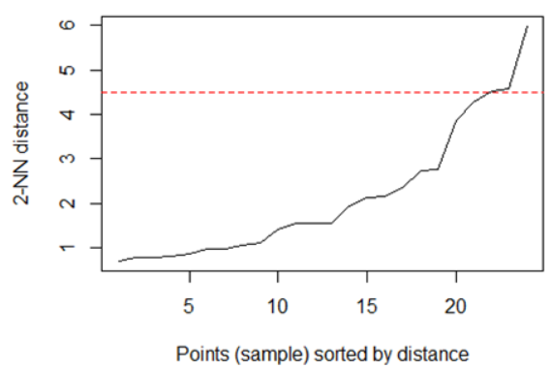
RESEARCH QUESTION 1
?
How do K-means and DBSCAN compare in terms of accuracy and handling outliers.
02
Key Concepts
Epsilon (eps): This parameter defines the radius of the neighborhood around each data point. Points within this radius are considered neighbors.
Minimum Points (minPts): This is the minimum number of points required to form a dense region, which is considered a cluster. A point needs at least minPts within its epsilon neighborhood to be classified as a core point.
Core Point: A point that has at least minPts other points within its eps-radius. Core points are the building blocks of clusters.
Border Point: A point that has fewer than minPts points within its eps-radius but lies within the eps-radius of a core point. These are on the edges of clusters.
Noise Point: A point that is not a core point and does not meet the criteria to be a border point either. These are often outliers or background noise in the data.

Slide 24
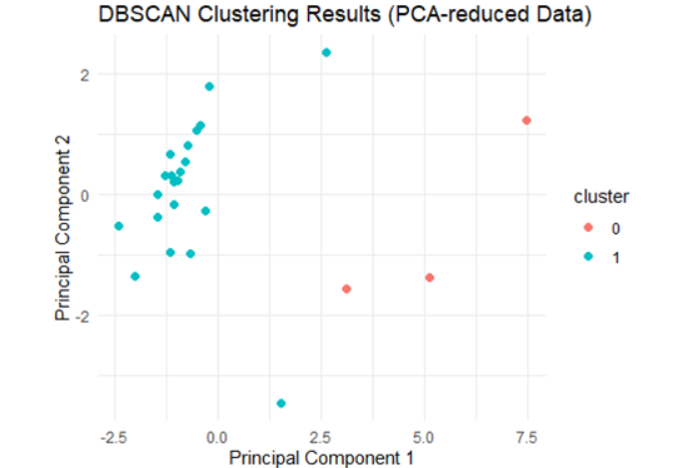
RESEARCH QUESTION 1
?
How do K-means and DBSCAN compare in terms of accuracy and handling outliers.
03
Comparison of K-Means and DBSCAN Based on PCA Plots
K-Means Clustering:
- Shows two clusters. - This method does not inherently detect noise. - All points are assigned to one of the clusters, including outliers & noise.
DBSCAN Clustering:
- Shows one cluster and identifies noise points. - This method is better at handling noise and outliers, explicitly marking them. - Based on the PCA plot from DBSCAN, we can clearly see that there are 3 outliers which are away from the cluster. DBSCAN was able to detect these outliers, while K-Means was not.

Slide 25
RESEARCH QUESTION 2
?
What is the Davies-Bouldin score in clustering evaluation, how does it differ from the Silhouette score, and how do their combined insights enhance understanding of cluster separation and cohesion?
01
Literature Review
The research article "Distance Analysis Measuring for Clustering using K-Means and Davies Bouldin Index Algorithm" published in the TEM Journal examines the effectiveness of different distance measures in clustering, using the Davies-Bouldin Index (DBI) to evaluate performance. The study focuses on the number of villages with primary school facilities in Indonesia. Various distance measures, such as Mixed Euclidean Distance, Generalized Divergence, Squared Euclidean Distance, Mahalanobis Distance, and Euclidean Distance, were tested.
The DBI, which assesses the average similarity ratio of each cluster with its most similar cluster, indicated that a lower value signifies better clustering. The research found that the Mixed Euclidean Distance with a cluster number (k = 2) produced the best DBI value of 0.269, highlighting the most optimal clustering setup. This underscores the DBI's utility in conjunction with diverse distance measures to achieve high-quality clustering results.

Slide 26
RESEARCH QUESTION 2
?
What is the Davies-Bouldin score in clustering evaluation, how does it differ from the Silhouette score, and how do their combined insights enhance understanding of cluster separation and cohesion?
02
Difference from Silhouette Score and Combined Insights
Silhouette Score: More intuitive and interpretable for individual points and overall clustering. It provides detailed insight into the clustering structure within the crime dataset.
Davies-Bouldin Index (DBI): Focuses on cluster separation and compactness, providing a single overall score. A DBI of 1.075 for the crime dataset suggests relatively well-defined clusters but not perfect separation.
Combined Insights: Using both metrics offers a comprehensive evaluation. The Silhouette Score provides detailed insights, while the DBI gives an overarching measure, confirming reasonably good clustering quality in the crime dataset.

Slide 27
DATASET FOR Partitional Clustering
DATA COLLECTION
1
№ | Feature | Description
1 | InvoiceNo | Code uniquely assigned to each distinct product.If this code starts with letter 'c', it indicates a cancellation.
2 | StockCode | Code uniquely assigned to each distinct product.
3 | Description | Description of each product.
4 | Quantity | The number of units of a product in a transaction.
5 | InvoiceDate | The date and time of the transaction.
6 | UnitPrice | The unit price of the product in sterling.
7 | CustomerID | Identifier uniquely assigned to each customer.
8 | Country | The country of the customer.
Name : E-Commerce Data Customer Segmentation
Data Source : Kaggle
(https://www.kaggle.com/code/xunbch/customer-segmentation-recommendation-system/input)
Representing individual transactions made by customers.
Providing attributes related to each transaction.
541,909 RECORDS
8 FEATURES

Slide 28
IMPACTFUL APPLICATIONS
01
03
Personalized Marketing Tailor marketing efforts based on customer purchasing behaviors and demographics by clustering similar customers together.
Inventory Management Optimize stock levels by understanding buying patterns of different customer segments through clustering.
02
04
Product Recommendations Improve recommendations by suggesting products liked by similar users within the same cluster.
Churn Prediction Identify and target customer clusters at higher risk of churning with specific retention strategies to increase loyalty.

Slide 29
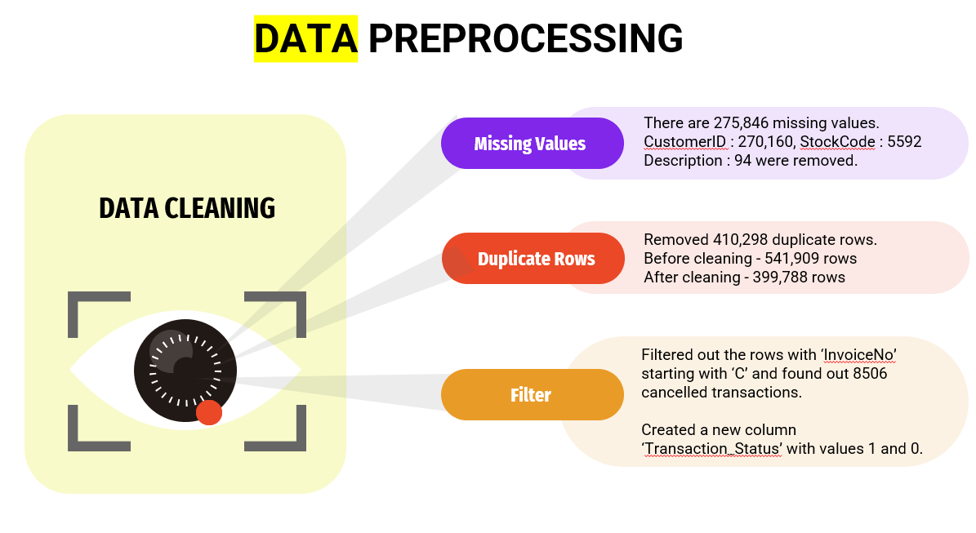
DATA PREPROCESSING
There are 275,846 missing values. CustomerID : 270,160, StockCode : 5592 Description : 94 were removed.
Missing Values
DATA CLEANING
Removed 410,298 duplicate rows.
Before cleaning - 541,909 rows
After cleaning - 399,788 rows
Duplicate Rows
Filtered out the rows with ‘InvoiceNo’ starting with ‘C’ and found out 8506 cancelled transactions.
Created a new column ‘Transaction_Status’ with values 1 and 0.
Filter

Slide 30
FEATURE ENGINEERING
RFM Features
RFM is a method used for analyzing customer value and segmenting the customer base. It is an acronym that stands for:
01 | Recency (R): This metric indicates how recently a customer has made a purchase. A lower recency value means the customer has purchased more recently, indicating higher engagement with the brand.
02 | Frequency (F): This metric signifies how often a customer makes a purchase within a certain period. A higher frequency value indicates a customer who interacts with the business more often, suggesting higher loyalty or satisfaction.
03 | Monetary (M): This metric represents the total amount of money a customer has spent over a certain period. Customers who have a higher monetary value have contributed more to the business, indicating their potential high lifetime value.
Together, these metrics help in understanding a customer's buying behavior and preferences, which is pivotal in personalizing marketing strategies.

Slide 31
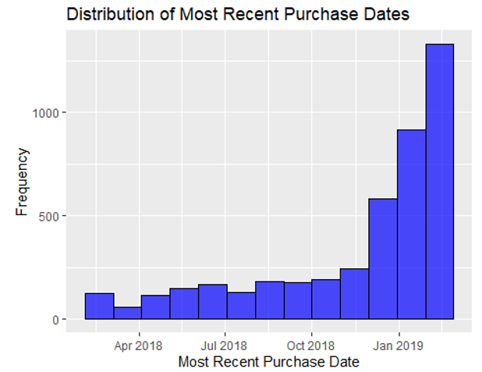
FEATURE ENGINEERING
Recency (R)
Days Since Last Purchase: This feature represents the number of days that have passed since the customer’s last purchase. A lower value indicates that the customer has purchased recently, implying a higher engagement level with the business, whereas a higher value may indicate a lapse or decreased engagement. By understanding the recency of purchases, businesses can tailor their marketing strategies to re-engage customers who have not made purchases in a while, potentially increasing customer retention and fostering loyalty.

Slide 32
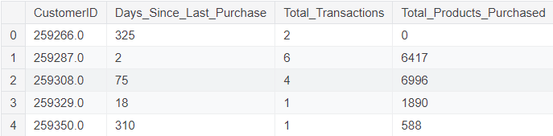
FEATURE ENGINEERING
Frequency (F)
Total Transactions: This feature represents the total number of transactions made by a customer. It helps in understanding the engagement level of a customer with the retailer.
Total Products Purchased: This feature indicates the total number of products (sum of quantities) purchased by a customer across all transactions. It gives an insight into the customer's buying behavior in terms of the volume of products purchased.

Slide 33
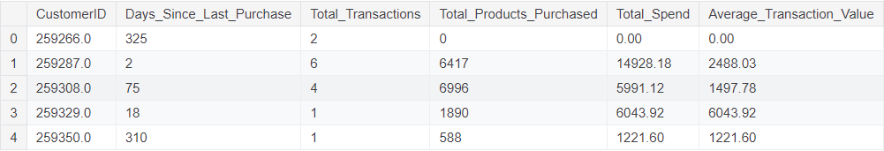
FEATURE ENGINEERING
Monetary (M)
Total Spend: This feature represents the total amount of money spent by each customer. It is calculated as the sum of the product of UnitPrice and Quantity for all transactions made by a customer. This feature is crucial as it helps in identifying the total revenue generated by each customer, which is a direct indicator of a customer's value to the business.
Average Transaction Value: This feature is calculated as the Total Spend divided by the Total Transactions for each customer. It indicates the average value of a transaction carried out by a customer. This metric is useful in understanding the spending behavior of customers per transaction, which can assist in tailoring marketing strategies and offers to different customer segments based on their average spending patterns.

Slide 34
FEATURE ENGINEERING
Product Diversity
Unique Products Purchased: This feature represents the number of distinct products bought by a customer. A higher value indicates that the customer has a diverse taste or preference, buying a wide range of products, while a lower value might indicate a focused or specific preference. Understanding the diversity in product purchases can help in segmenting customers based on their buying diversity, which can be a critical input in personalizing product recommendations.
Behavioural Features
Average Days Between Purchases: This feature represents the average number of days a customer waits before making another purchase. Understanding this can help in predicting when the customer is likely to make their next purchase, which can be a crucial metric for targeted marketing and personalized promotions.
Favorite Shopping Day: This denotes the day of the week when the customer shops the most. This information can help in identifying the preferred shopping days of different customer segments, which can be used to optimize marketing strategies and promotions for different days of the week.
Favorite Shopping Hour: This refers to the hour of the day when the customer shops the most. Identifying the favorite shopping hour can aid in optimizing the timing of marketing campaigns and promotions to align with the times when different customer segments are most active.
Geographic Features
Country: This feature identifies the country where each customer is located. Including the country data can help us understand region-specific buying patterns and preferences. Different regions might have varying preferences and purchasing behaviors which can be critical in personalizing marketing strategies and inventory planning.

Slide 35
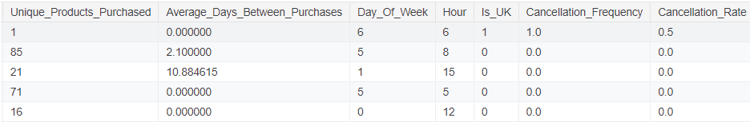
FEATURE ENGINEERING
Cancellation Insights
Cancellation Frequency: This metric represents the total number of transactions a customer has canceled. Understanding the frequency of cancellations can help us identify customers who are more likely to cancel transactions. This could be an indicator of dissatisfaction or other issues, and understanding this can help us tailor strategies to reduce cancellations and enhance customer satisfaction.
Cancellation Rate: This represents the proportion of transactions that a customer has canceled out of all their transactions. This metric gives a normalized view of cancellation behavior. A high cancellation rate might be indicative of an unsatisfied customer segment. By identifying these segments, we can develop targeted strategies to improve their shopping experience and potentially reduce the cancellation rate.

Slide 36
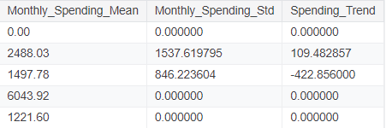
FEATURE ENGINEERING
Seasonality & Trends
Monthly_Spending_Mean: This is the average amount a customer spends monthly. It helps us gauge the general spending habit of each customer. A higher mean indicates a customer who spends more, potentially showing interest in premium products, whereas a lower mean might indicate a more budget-conscious customer.
Monthly_Spending_Std: This feature indicates the variability in a customer's monthly spending. A higher value signals that the customer's spending fluctuates significantly month-to-month, perhaps indicating sporadic large purchases. In contrast, a lower value suggests more stable, consistent spending habits. Understanding this variability can help in crafting personalized promotions or discounts during periods they are expected to spend more.
Spending_Trend: This reflects the trend in a customer's spending over time, calculated as the slope of the linear trend line fitted to their spending data. A positive value indicates an increasing trend in spending, possibly pointing to growing loyalty or satisfaction. Conversely, a negative trend might signal decreasing interest or satisfaction, highlighting a need for re-engagement strategies. A near-zero value signifies stable spending habits. Recognizing these trends can help in developing strategies to either maintain or alter customer spending patterns, enhancing the effectiveness of marketing campaigns.

Slide 37
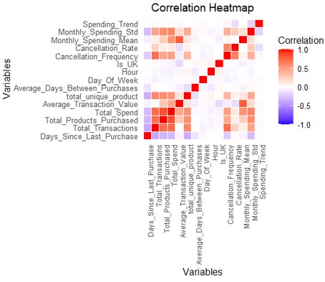
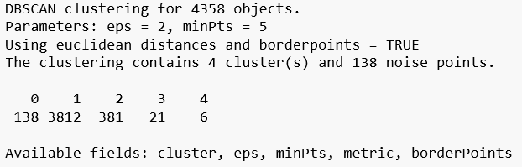
Outlier Detection AND Correlation Analysis
Outliers Detected | 138
Outliers Percentage | 3.17%
Variable 1 | Variable 2 | Correlation
Total_Transactions | Total_Products_Purchased | 0.72
Total_Transactions | Total_Spend | 0.74
Total_Products_Purchased | Total_Spend | 0.85
Cancellation_Frequency | Total_Transactions | 0.72

Slide 38
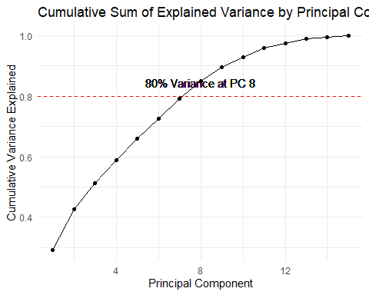
DIMENSIONALITY REDUCTION
Multicollinearity Detected: We identified that our dataset contains multicollinear features. Dimensionality reduction can help us remove redundant information and alleviate the multicollinearity issue.
Better Clustering with K-means: Since K-means is a distance-based algorithm, having a large number of features can sometimes dilute the meaningful underlying patterns in the data. By reducing the dimensionality, we can help K-means to find more compact and well-separated clusters.
Noise Reduction: By focusing only on the most important features, we can potentially remove noise in the data, leading to more accurate and stable clusters.
Transformation: Transformed the data using the first 8 principal components.

Slide 39
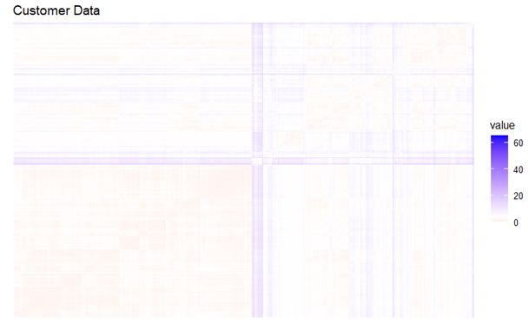
ASSESSING CLUSTERING TENDENCY
Why It's Important?
Assessing clustering tendency is crucial to determine if the data naturally groups into clusters, which validates the applicability of clustering algorithms. Without this step, applying clustering methods could yield misleading or non-informative results.
1.00
Hopkins statistic
Clear Blocks
VAT Heat Map
PCA transformed clustering tendency.
Clear separated areas, suggesting this dataset is clusterable.

Slide 40


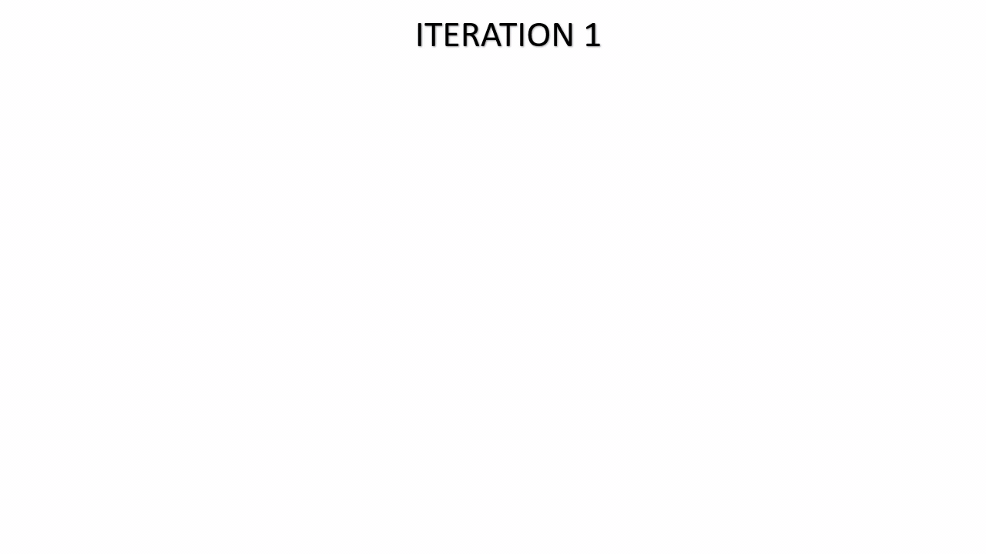



PARTITIONAL CLUSTERING
1. K-Means Clustering
Lloyd's algorithm, often simply referred to as the k-means algorithm, is the standard approach to k-means clustering and involves the following steps:
Assignment stage (a)
Assignment stage (b)
Initialization stage
Recalculate stage
Repeat
Result

Slide 41
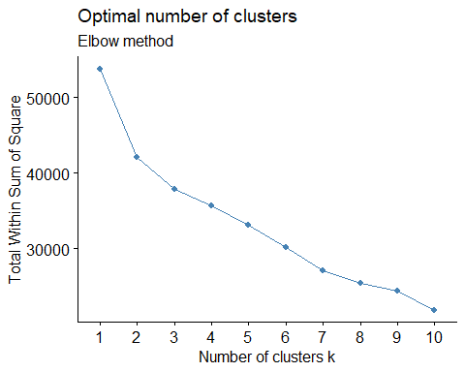
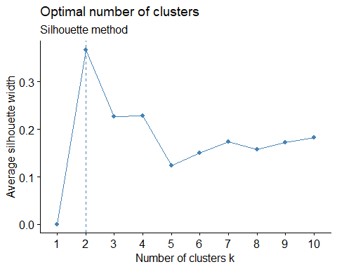
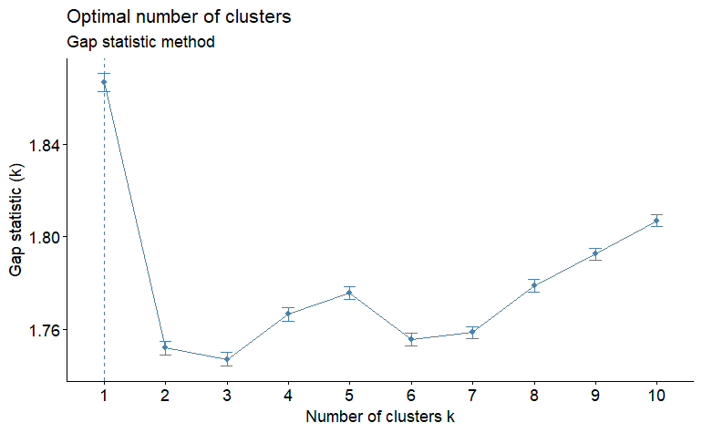
CHOOSING THE OPTIMAL NUMBER OF CLUSTERS
Elbow
Method
2 Clusters
Silhouette
Method
2 Clusters
Gap Statistic
Method
1 Cluster

Slide 42
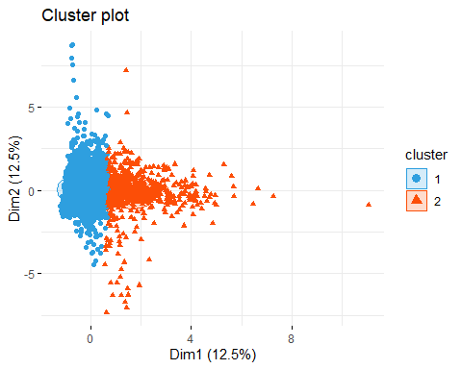
K-MEANS 2-D CLUSTER PLOT
Observations
Cluster 1 (Blue Circles): This cluster is tightly grouped around the center-left part of the plot. The compactness of this cluster suggests that the data points within this group are quite similar to each other based on the features represented in Dimension 1 and Dimension 2.
Cluster 2 (Red Triangles): This cluster is spread out more towards the center-right side of the plot. Compared to Cluster 1, it shows a bit more dispersion, which indicates a greater variance within the data points in this cluster.

Slide 43
PARTITIONAL CLUSTERING
2. Partitioning Around Medoid (PAM)
PAM (Partitioning Around Medoids) is a specific implementation of the k-medoids algorithm. It is widely used and well-known for its robustness to outliers compared to k-means, because a medoid, being an actual data point, is less influenced by outliers than a mean.
Notes:
**Slide 1: Introduction to PAM**
Hello, this is Hassan.
Here, i will introduce our analysis using PAM
Partitioning Around Medoids, commonly known as PAM, is a variation of the k-medoids algorithm. Unlike k-means, PAM is renowned for its resilience against outliers. pam use medoids, actual data points that represent the clusters, making the algorithm less sensitive to extreme values compared to the mean used in k-means.

Slide 44
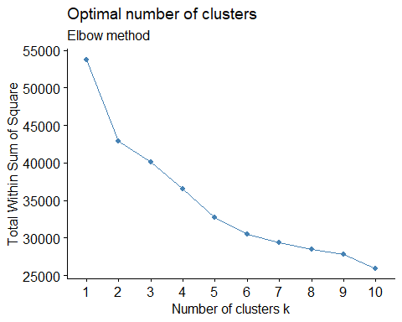
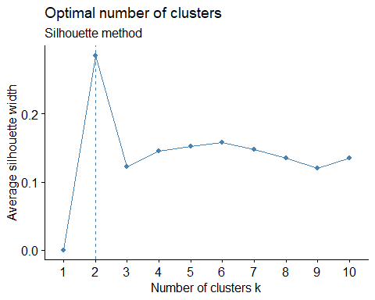
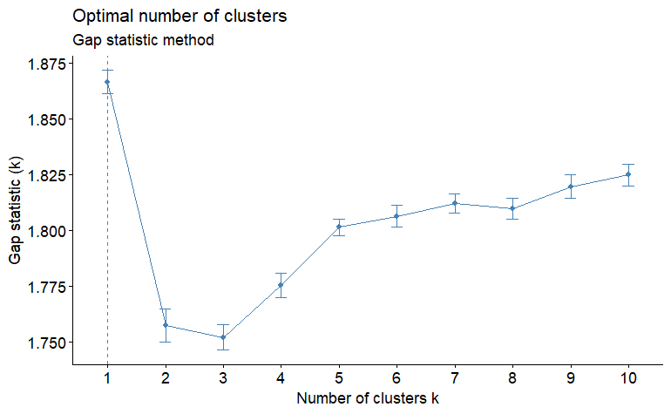
CHOOSING THE OPTIMAL NUMBER OF CLUSTERS
Elbow
Method
2 Clusters
Silhouette
Method
2 Clusters
Gap Statistic
Method
1 Cluster
Notes:
**Slide 2: Choosing the Optimal Number of Clusters**
Here we choose the optimal number of clusters for pam
we use three techniques.
- The **Elbow Method**, which helps identify the point where the within-cluster sum of squares (WCSS) begins to diminish more slowly.
- The **Silhouette Method**, which assesses the average silhouette width to determine the compactness and separation of clusters.
- The **Gap Statistic Method**, which compares the total within intra-cluster variation for different numbers of clusters with their expected values under null reference distribution.
In our analysis, both the Elbow and Silhouette methods suggest that two clusters are optimal, whereas the Gap Statistic points to one.
we decide the optimal k is 2.

Slide 45
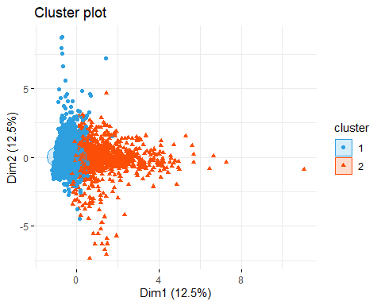
PAM 2-D CLUSTER PLOT
Observations
Cluster 1 (Blue Circles): This cluster is concentrated around the left part of the plot, suggesting that these data points are closely related in terms of their attributes represented by Dim1 and Dim2. The dense nature of this cluster implies that these attributes are quite homogeneous within this group.
Cluster 2 (Red Triangles): This cluster is more spread out compared to Cluster 1, covering a broader area in the plot mainly to the right side. This spread suggests a higher variation within the cluster compared to Cluster 1.
Notes:
**Slide 3: PAM 2-D Cluster Plot**
Visualizing the results, the 2-D cluster plot of PAM reveals two distinct clusters:
- **Cluster 1 (Blue Circles)**, concentrated on the left, indicates closely related data points with homogeneous attributes.
- **Cluster 2 (Red Triangles)**, more spread out, suggests higher variation within the cluster.

Slide 46
CLUSTER VALIDATION STATISTICS
01
02
INTERNAL VALIDATION MEASURES
STABILITY VALIDATION MEASURES
Silhouette Score
Dunn Index
Connectivity
ADM
AD
APN
FOM
Notes:
**Slide 4: Cluster Validation Statistics**
To ensure the clusters' validity, we use both internal and stability validation measures:
- **Internal Measures** like Silhouette Score, Dunn Index, and Connectivity assess the quality based on the data's intrinsic properties.
- **stability Measures** .

Slide 47
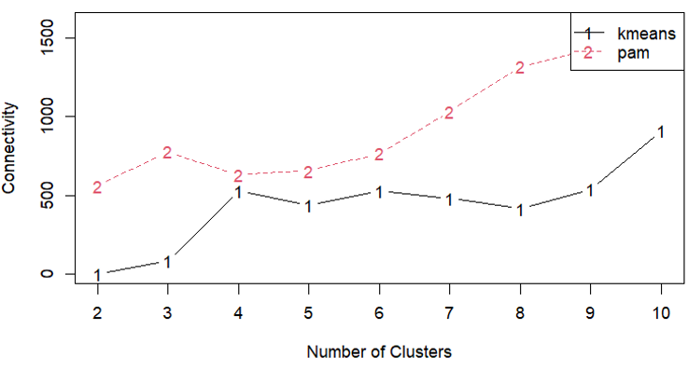


INTERNAL VALIDATION MEASURES
Conclusion
Partitional Clustering Recommended: Based on internal validation metrics, K-Means clustering with two clusters is most effective, achieving the lowest connectivity and highest silhouette score.
Notes:
**Slide 5: Internal Validation Measures**
Our internal validation metrics strongly recommend kmeans. For instance, with two clusters, k-means achieves the lowest connectivity and the highest silhouette score and dunn score, indicating a more effective clustering solution.

Slide 48

STABILITY MEASURES IN CLUSTER VALIDATION
Importance
Ensuring stability in clustering is crucial for confirming that the identified clusters are reliable and not artifacts of specific data peculiarities or the clustering process.
FOUR TYPES
Average Proportion of Non-overlap (APN) | Measures the average dissimilarity between clusters obtained from the dataset and those from subsamples.
Average Distance (AD) | Calculates the average distance between elements in the same cluster across different clustering solutions.
Average Distance between Means (ADM) | Evaluates the stability of cluster centroids by measuring the distance between centroids in different subsamples.
Figure of Merit (FOM) | Focuses on the within-cluster dispersion and its variation across different subsamples.
Notes:
**Slide 7: Stability Measures in Cluster Validation**
Stability is crucial in clustering to confirm the reliability of identified clusters. We examine:
- **Average Proportion of Non-overlap (APN)**, which measures the dissimilarity between clusters from the dataset and subsamples.
- **Average Distance (AD)** within clusters across different solutions.
- **ADM evaluates the centroid stability.
- **FOM** focuses on within-cluster dispersion.

Slide 49




STABILITY MEASURES IN CLUSTER VALIDATION
ADM scores suggests kmeans with k=2 is optimal.
FOM scores suggests kmeans with k=10 is optimal.
AD scores suggests pam with k=10 is optimal.
APN scores suggests kmeans with k=2 is optimal.
Notes:
Our stability measures indicate:
- **ADM** suggests k-means with two clusters.
- **FOM** supports k-means with ten clusters.
- **AD** favors PAM with ten clusters.
**APN** also points to
k-means with two clusters.

Slide 50

Cluster Distribution Visualization
Silhouette score: Prepared a dataset with K-Means k=2 clustering result and original customer data.
The average silhouette width is 0.64
Cluster 1: Size: 3444, ASW: 0.77 This cluster has a higher average silhouette width, indicating that the points in this cluster are better clustered and more distinct from points in other clusters.
Cluster 2: Size: 776, ASW: 0.04 This indicates that cluster 2 has a low silhouette width, suggesting that the points in this cluster are not well separated from other clusters and may be misclassified
Conclusion:
Cluster Quality: Cluster 1 is relatively well-defined with an average silhouette width of 0.77, indicating good clustering quality. However, Cluster 2 has a very low silhouette width of 0.04, indicating poor clustering quality and potential issues with the clustering algorithm’s ability to distinguish this cluster from others.
Overall Clustering: The overall average silhouette width of 0.64 suggests that the clustering solution is moderate.
Notes:
**Slide 8: Cluster Distribution Visualization**
Finally, examining the silhouette score, we observe:
**Cluster 1** boasts a higher silhouette width of 0.77, indicating well-defined clustering.
- **Cluster 2** has a low silhouette width of 0.04, indicating poor separation.
The overall average silhouette width of 0.64 suggests moderate clustering quality.

Slide 51


Cluster Distribution Visualization
CLUSTER ANALYSIS AND PROFILING
Analyzing the characteristics of each cluster to understand the distinct behaviors and preferences of different customer segments and also profiling each cluster to identify the key traits that define the customers in each cluster.
Cluster 1
Cluster 2
Conclusion:
Cluster 1: “High Spend Frequent Buyers”: High spending and frequent purchases with a variety of products.
Cluster 2: “Low Spend Infrequent Buyers”: Low spending and infrequent purchases with limited product variety.
Notes:
**Slide 9: Cluster Analysis and Profiling**
We profile our clusters to understand their characteristics better:
- **Cluster 1**: "High Spend Frequent Buyers" with frequent purchases and high spending.
- **Cluster 2**: "Low Spend Infrequent Buyers" with sporadic purchases and lower spending.
In conclusion, These clustering results can be utilized to tailor marketing strategies and improve customer engagement:
- **Cluster 1: "High Spend Frequent Buyers"** - Targeted with loyalty programs, premium offers, and personalized recommendations to enhance retention and maximize their lifetime value.
- **Cluster 2: "Low Spend Infrequent Buyers"** - Engaged through promotional offers, re-engagement campaigns, and incentives to increase their purchase frequency and spending.
By understanding these distinct customer profiles, businesses can develop more effective, data-driven marketing strategies to optimize revenue and customer satisfaction.

Slide 52
Thank You
Notes:
Thank you for watching our presentation.
let us know you have any questions through emails .
And have a nice day.

